Slide 1
Lexical flexibility in English: A preliminary study
10/16/2019
Daniel W. Hieber
University of California, Santa Barbara
danielhieber.com
College of William & Mary, Department of Linguistics, Williamsburg, VA

Slide 2
What part of speech is friend?
Noun
Verb
Adjective
Notes:
[Take a poll]

Slide 3
friend as Noun
I got a spooky box from my best friends.
Secrets don't make friends, Luke.
Just think I saw an old college friend on TV meeting Hilary Clinton.
Notes:
Twitter data from W&M students

Slide 4
friend as Verb
What's your user? I would love to friend you and look at it when finished!
If we don't have mutual friends we can't get friended.
I accidentally downloaded Facebook and created a profile and friended a bunch of people.

Slide 5
friend as Adjective
the guy became the national symbol of friend zone in just a day
Facebook just put me in the damn friend zone with my wife
can someone help me with some friend drama?

Slide 6
What does the dictionary say?
Dictionary.com: verb, noun
Merriam-Webster: verb, noun
Why not adjectives?

Slide 7
Nouns Modifying Nouns
Are they compounds?
health care vs. healthcare
friend zone vs. friendzone
Notes:
Tempted to analyze nouns modifying nouns as compounds. Does this work?

Slide 8
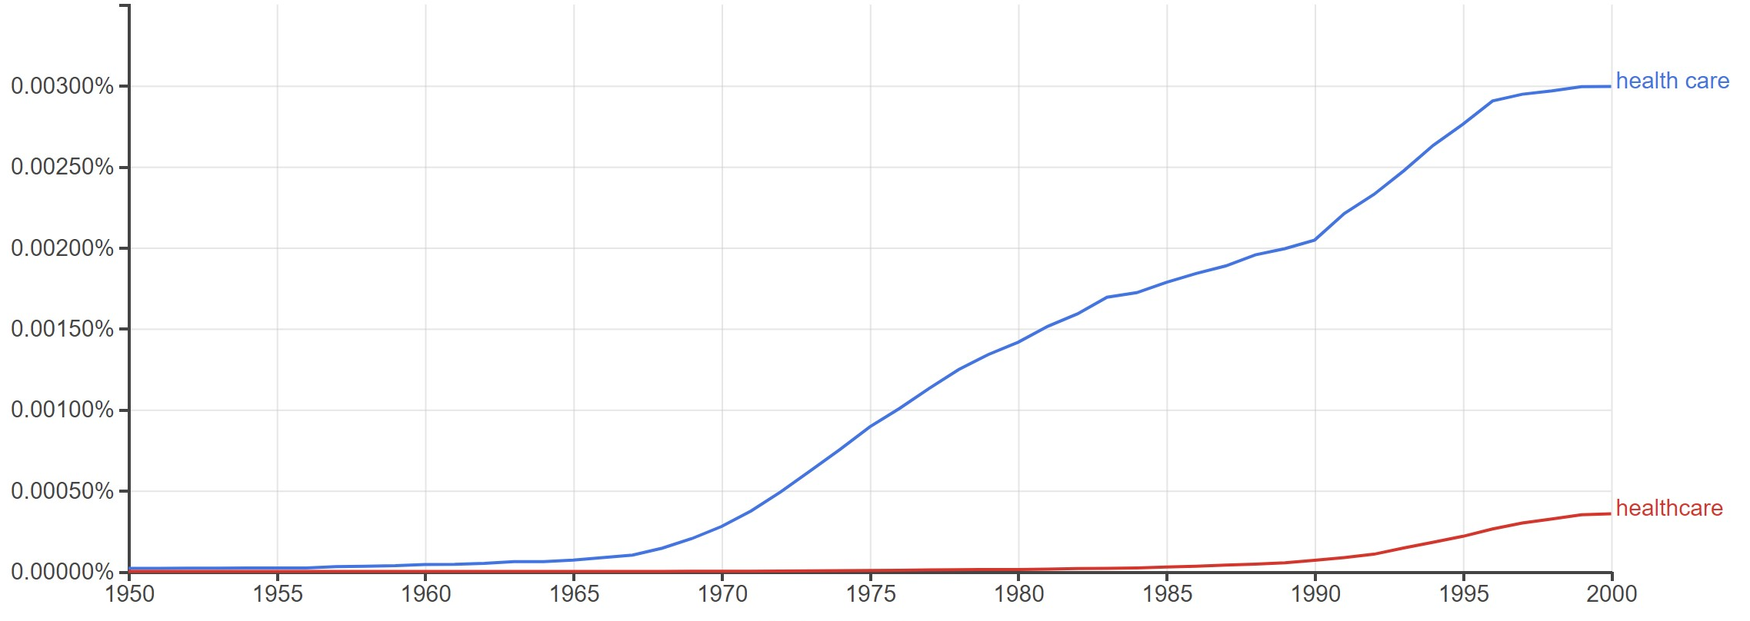
health care vs. healthcare (Google Books)
Notes:
In some cases, nouns modifying nouns do become compounds.
But not in every case.

Slide 9
Nouns Modifying Nouns
Are they compounds?
health care vs. health care
friend zone vs. friendzone
We don’t analyze these as adjectives because:
tradition
the change is unmarked
Notes:
friendzone doesn’t (yet) appear in the Google Books corpus
Linguists selective about their criteria
Cherry pick to accommodate:
tradition
their theoretical perspective

Slide 10
Aside
the truth is they friendzone everyone who tries to be with them
just ate two slices of veggie pizza for lunch so basically I'm all healthed up for at least a month
Notes:
friendzone – does appear on Twitter; entire phrase can become lexicalized (a new meaningful word in itself)
healthed – very unexpected use of this word as a verb

Slide 11
able
N: that feeling of abling to run 22 miles a week
V: always abling and abetting the horses
A: an able mind overcomes challenges

Slide 12
time
N: still one of my favorite series of all time
V: I'm so bored in this class that I'm timing how long I can hold my breath
A: 2 years ago today (or yesterday depending on your time zone)

Slide 13
Parts of Speech in English
How common is flexibility in English?
rigid vs. flexible words
Notes:
lexical vs. grammatical words
English is sometimes claimed to be rigid, sometimes flexible

Slide 14
A crosslinguistic problem

Slide 15
Nuuchahnulth (Wakashan; Pacific Northwest)
mamuːk-ma quːʔas-ʔi
working-PRES(INDIC) man-DEF
‘the man is working’
quːʔas-ma mamuːk-ʔi
man-PRES(INDIC) working-DEF
‘the working one is a man’

Slide 16
Nuuchahnulth (Wakashan; Pacific Northwest)
mamuːk-ma quːʔas-ʔi
working-PRES(INDIC) man-DEF
‘the man is working’
quːʔas-ma mamuːk-ʔi
man-PRES(INDIC) working-DEF
‘the working one is a man’
Notes:
Flexibility is present for both words

Slide 17
Central Alaskan Yup’ik (Eskimo-Aleut)
angya-qa ‘my boat’
ner’a-qa ‘I am eating it’
angya-a ‘his/her boat’
ner’a-a ‘he/she/it is eating it’
angya-at ‘their boat’
nera-at ‘they are eating it’
Notes:
Entire paradigm matches

Slide 18
Central Alaskan Yup’ik
“In the Eskimo mind the line of demarcation between the noun and the verb seems to be extremely vague, as appears from the whole structure of the language, and from the fact that the inflectional endings are, partially at any rate, the same for both nouns and verbs.” (p. 1057)
Thalbitzer, W. 1911. Eskimo. In Franz Boas (ed.), Handbook of American Indian Languages (Bureau of American Ethnology Bulletin 40), 967–1069.

Slide 19
Riau Indonesian (Austronesian)
ayam makan
chicken eat
The chicken is eating.
The chicken is being eaten.
The chicken is making somebody eat.
Somebody is eating for the chicken.
Somebody is eating where the chicken is.
the chicken that is eating
where the chicken is eating
when the chicken is eating
how the chicken is eating
Notes:
Famously claimed by David Gil to lack parts of speech entirely.

Slide 20
Mundari (Austroasiatic)
buru=ko bai-ke-d-a
mountain=3pl.s make-compl‑tr‑indic
‘They made the mountain.’
saan=ko buru-ke-d-a
firewood=3pl.s mountain‑compl‑tr‑indic
‘They heaped up the firewood.’

Slide 21
Flexibility with Fully-Inflected Words
Chitimacha (isolate; Louisiana)
dzampuyna
‘they usually thrust/spear (with it)’ = ‘a spear’
Mohawk (Iroquoian; Ontario / Quebec)
ieráhkhwa’
‘one puts things in with it’ = ‘a container’
Notes:
Mohawk: verbs show a cline from fully lexicalized to fully productive / analyzable; some words have both uses
I have yet to find a language where flexibility hasn’t been observed in sufficiently great amounts that it merits comment in the literature or a grammatical description.

Slide 22
The Problem of Lexical Flexibility

Slide 23
How to analyze lexical flexibility?
conversion / zero-derivation vs. underspecification
lexical flexibility is used in a neutral sense here
Notes:
conversion – traditional approach, favored by generativists / formalists (exception: Distributed Morphology)
underspecification – newer approach, gradually gaining proponents

Slide 24
What is a word?
lexeme
abstract representation (cognitive or grammatical) of a group of related wordforms
whatever it is that’s common to those wordforms (usually a stem)
lemma – conventional wordform used to represent a group of wordforms
keyword: conventional
token – a specific instance of a lexeme in discourse
Notes:
Determining what two uses of a form count as the same lexeme is tricky.
What we’re interested in when we’re talking about what counts as instances of the same “word” is actually a lexeme.
lexeme – abstract representation (cognitive or grammatical) of related wordforms; whatever it is that’s common to those wordforms (usually a stem)
example: help, helps, helped
example: eat, ate, eaten
example: am, is, are, was, were, be
lemma / headword – conventional wordform used to represent this bundle; just a matter of convention

Slide 25
How to determine wordhood?
words have many senses
Notes:
If a word has many different senses, where do we draw the line between one lexeme and the next?

Slide 26
Senses of run
Dictionary.com lists 148 senses of run, some nouns, some verbs (but again no adjectives)
fast pedestrian motion: I run every day
conduct a political campaign: he ran a fair campaign
come undone: these stockings run easily
operate or function: does it run well?
get or become: the well ran dry
Notes:
Should we count all of these as the same “word” / lexeme? Where do we draw the line?

Slide 27
How to determine wordhood?
words have many senses
grammatical categories vs. cognitive associations
categories are prototypal
derived words have unpredictable meanings
Notes:
Cognitive literature suggests that we have cognitive associations between historically related or synchronically similar wordforms, even if they’re totally different lexemes.
response times
priming effects
We do have some association between the many senses of run – probably a family network.
prototypal – They cluster around a prototype
prototypical noun: man
non-prototypical noun: running
Prototypicality established through:
listing experiments
response / recall time
corpus frequency
historical primacy (usually)
Predictability – since the meaning has changed (enough), it must be a new word
- BUT, some languages have cases of conversion which are predictable as well as cases which are not (Mandinka) (probably most languages)

Slide 28
Semantic Predictability
brother vs. brethren
cloth vs. clothes
new vs. news
(hunting) blind vs. (window) blinds
custom vs. customs
arm vs. arms
wood vs. woods
Notes:
Inflection also can create a significant shift in meaning
brother, cloth – historical divergence
blind – window interpretation not available in the singular
custom – international travel sense not available in the singular
arm – military force sense not available in the singular
wood – singular and plural refer to different types of things (a material vs. a collection)

Slide 29
Semantic Predictability
inflectional vs. derivational uses of the same morpheme
English –ing progressive / gerund
the running man (inflectional)
the running of the bulls (derivational)
Chitimacha –ma pluractional
guxma- ‘eat (multiple things)’ (inflectional)
haakxtema- ‘design’ (from haakxte- ‘draw’) (derivational)
Notes:
Can’t even be sure when a morpheme is acting inflectionally vs. derivationally
That is, we don’t know when it becomes a new word

Slide 30
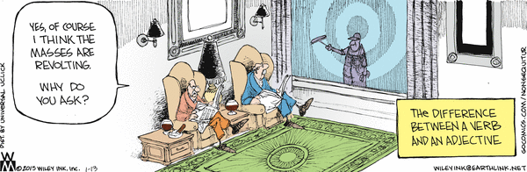
English –ing: Inflection vs. Derivation
Notes:
Note the caption here: The difference between a verb and an adjective

Slide 31
How to determine wordhood?
bad question
good questions
How common is flexibility / unmarked derivation?
Does the frequency / degree of flexibility vary from word to word?
Does the frequency / degree of flexibility vary from language to language?
Why are some instances of derivation marked, and others not? What’s special about the (un)marked ones?
Notes:
Given what we (don’t) know about lexical categories, I think this is an unhelpful question.
We know lexical relatedness is gradient and complex. Can we say something about it anyway?
We should treat lexical flexibility as an object of study in its own right, without assuming anything about the relatedness of different uses of a word.
Yes. These are my long-term research questions. This research project aims to tackle just the first question.

Slide 32
This Study

Slide 33
Research Questions
How flexible are the words of English, and English generally?
Does flexibility correlate with semantic domain?
Notes:
Question 2 is an initial attempt to determine what might motivate unmarked conversion.

Slide 34
Determining Degree of Flexibility
For a given word, count how often that word is used as a noun, verb, or adjective.
Calculate a flexibility score for that word – how evenly distributed its uses are across different categories.
Apply this method to each word in the language (or a representative sample of them)

Slide 35
Data & Methods
Spoken portion of the Open American National Corpus (OANC) (~3.5 million words) (not Twitter)
Randomly selected wordforms from 100 different frequency bins
Created a list of every instance of those 100 words (~380,000 tokens total)
Annotated each token for its function: noun, verb, adjective
Notes:
frequency vs. corpus dispersion – [mention if you have some time to fill]
Annotated 16 out of the 100 lexemes completely so far

Slide 36
Results

Slide 37
able
N: [none]
V: Are you able?
A: most of the able bodied Americans
Notes:
Noun: We saw a Twitter example earlier, but none appear in the OANC. The form abling doesn’t appear once.
Notice that there’s already a marked derivation for this: ability
This phenomenon is sometimes called blocking, though it’s unclear if this is actually what’s happening here
Vast majority of instances of able are attributive predicates, which is interesting because able is historically an adjective
Verbal uses are due to copula constructions, which are structurally equivalent to inflected verbs
I am ahead
I am running
Almost anything can be predicated in English, unmarked
Omnipredicativity – originally proposed for Nahuatl (Aztec)
appears to be a prevalent feature of all, possibly most, languages

Slide 38
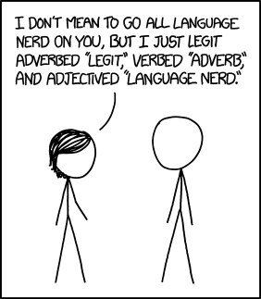
Omnipredicativity

Slide 39
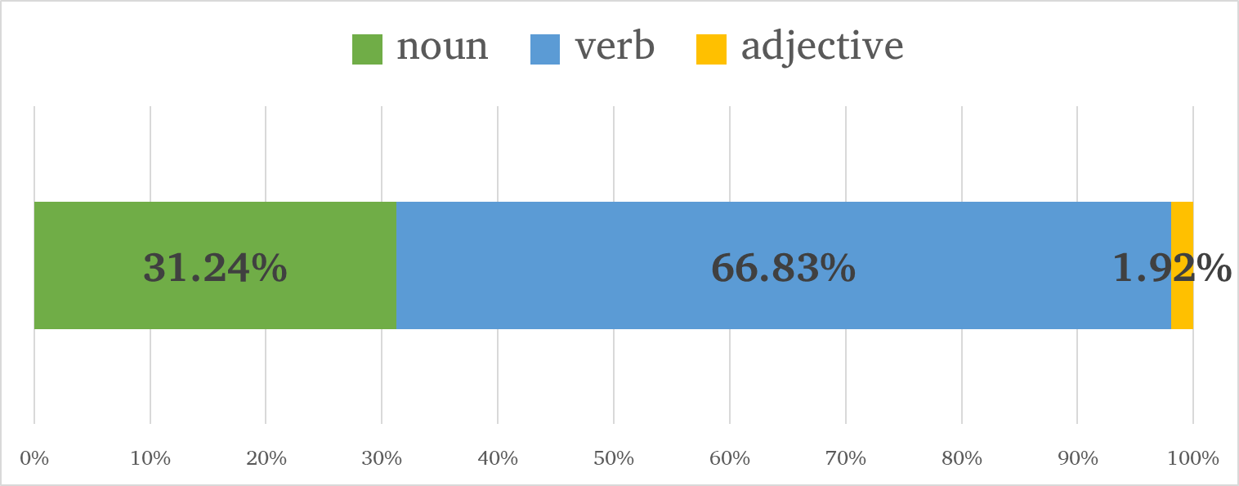
able

Slide 40
ahead
N: [none]
V: I’m ahead of him right now
A: [none]
Notes:
Adverbs like ahead were generally tricky. Frequently they seem like nouns functioning adverbially or functioning to modify. Historically they’re often nouns or locative phrases (at head)
I got ahead of him (reference)
the next guy ahead of me (modification)
Didn’t count cases like these unless they were really clear, but it makes me think adverbs are another area where we’re adhering to traditional ways of analyzing terms even when they aren’t appropriate to the actual data.

Slide 41
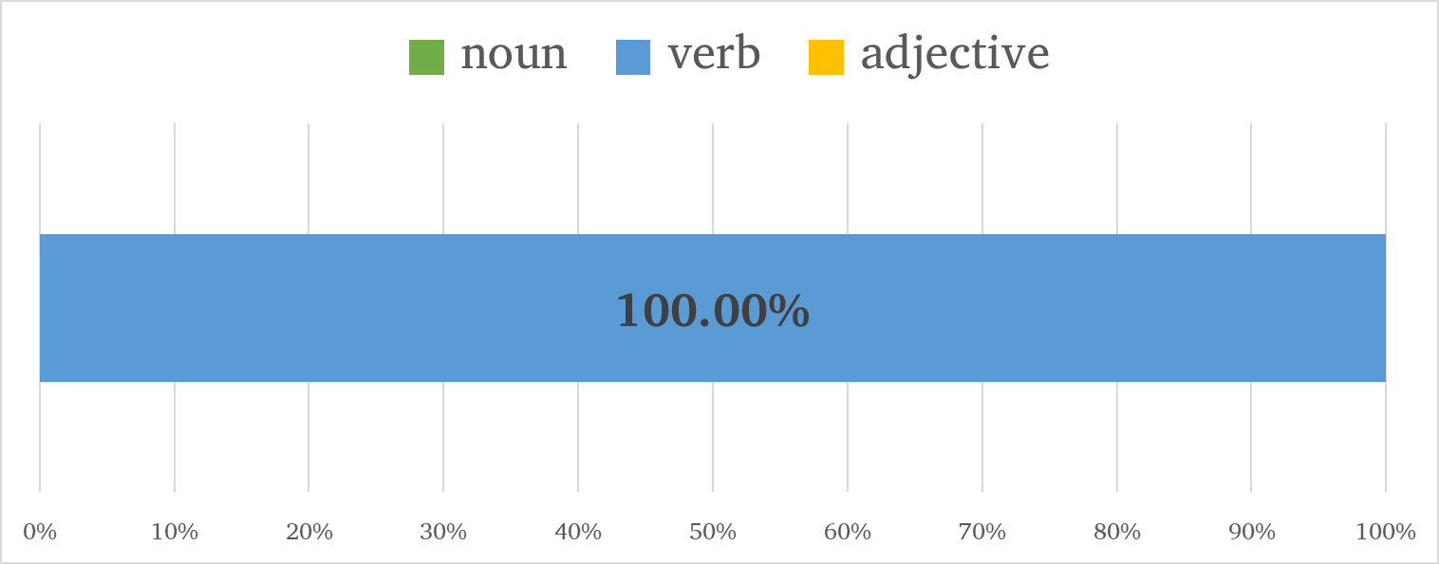
ahead

Slide 42
anything
N: I was never exposed to anything of the sort
V: it’s anything in that hobby line
A: [none]
Notes:
Not surprising. However it should be noted that you can find modifying and verbal examples online, not just for anything, but for just about anything!
V: She loads me down with goodies that she searches out as not being sprayed, shot, or artificially anythinged
A: that wasn't very country or very anything, really

Slide 43
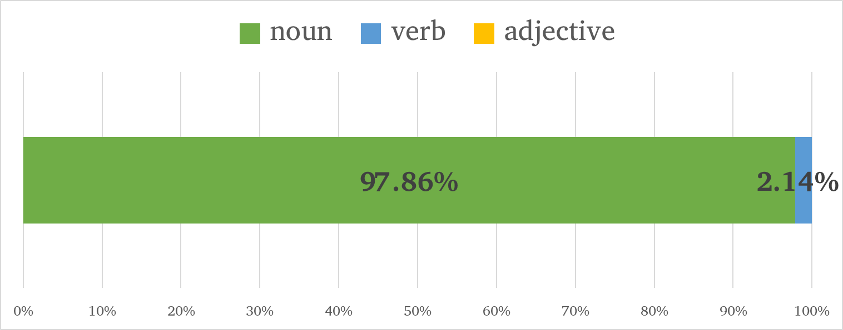
anything

Slide 44
back
N: hand print on the back of her leg
V: as I’m backing off I’m still keeping an eye on it
A: when I look out my back door
Notes:
Very easy to find instances of all three functions for back, even ignore attributive predicative cases

Slide 45
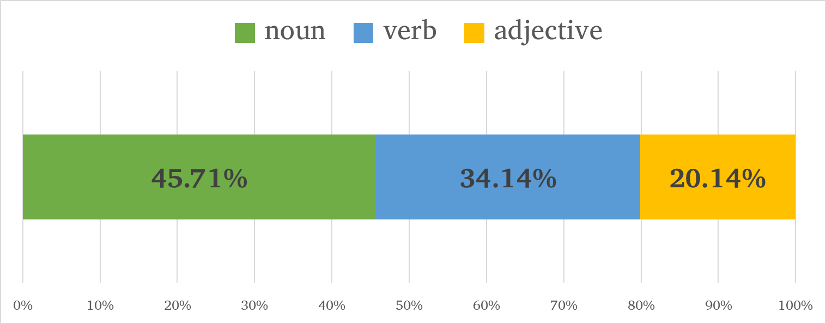
back

Slide 46
believe
N: I don’t have any choice but to believe it
N: all those feelings of believing
V: I don’t believe she read a lot
A: the believing scientist
Notes:
N: infinitives are traditionally analyzed as a verbal inflection, but infinitives are typologically noun-like, and they’re often considered a nominal form of a verb

Slide 47
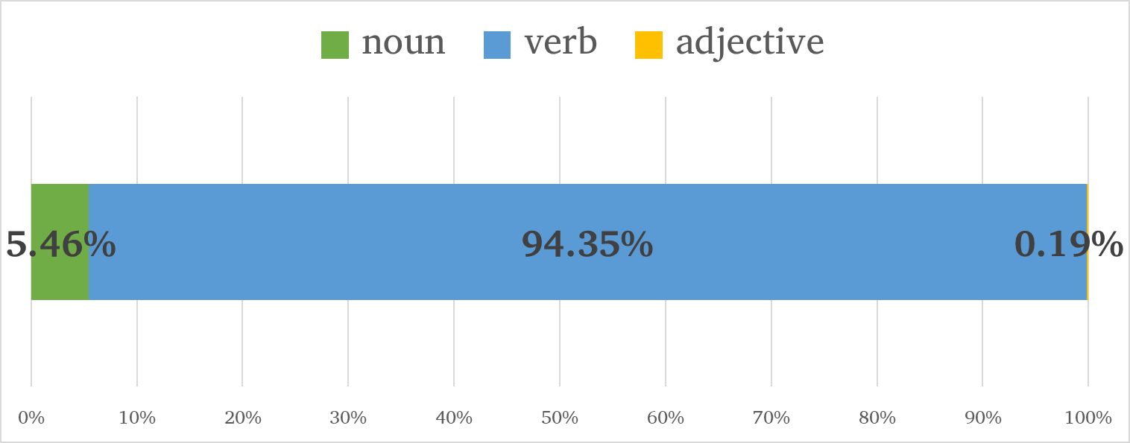
believe

Slide 48
best
N: summer is the best
V: the new crew was best
A: he is one of the best actors
Notes:
For the attributive predicative uses, I’d like to go back and recode them as a distinct category.
V: could also have been to best someone, but that use didn’t appear in the OANC
Future research question: Can we determine the prototypical use of a word by the distribution of its functions?
adjective: primarily adjective, some noun
noun: primarily noun, some verb, some adjective
verb: primarily verb, some noun, little to no adjective

Slide 49
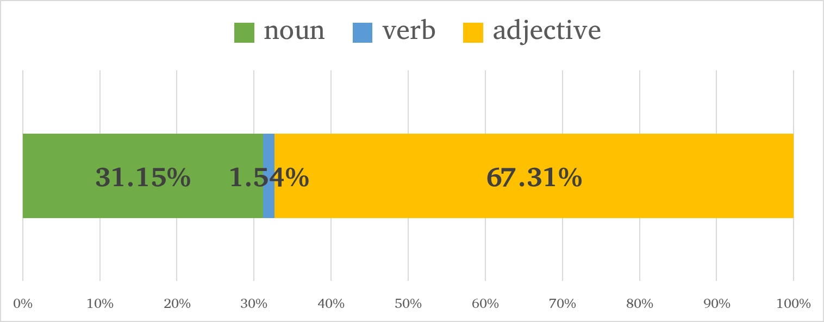
best

Slide 50
bill
N: the bill always comes in
V: they could bill Uncle Sam for that hospital care
A: bills wise we divide everything

Slide 51
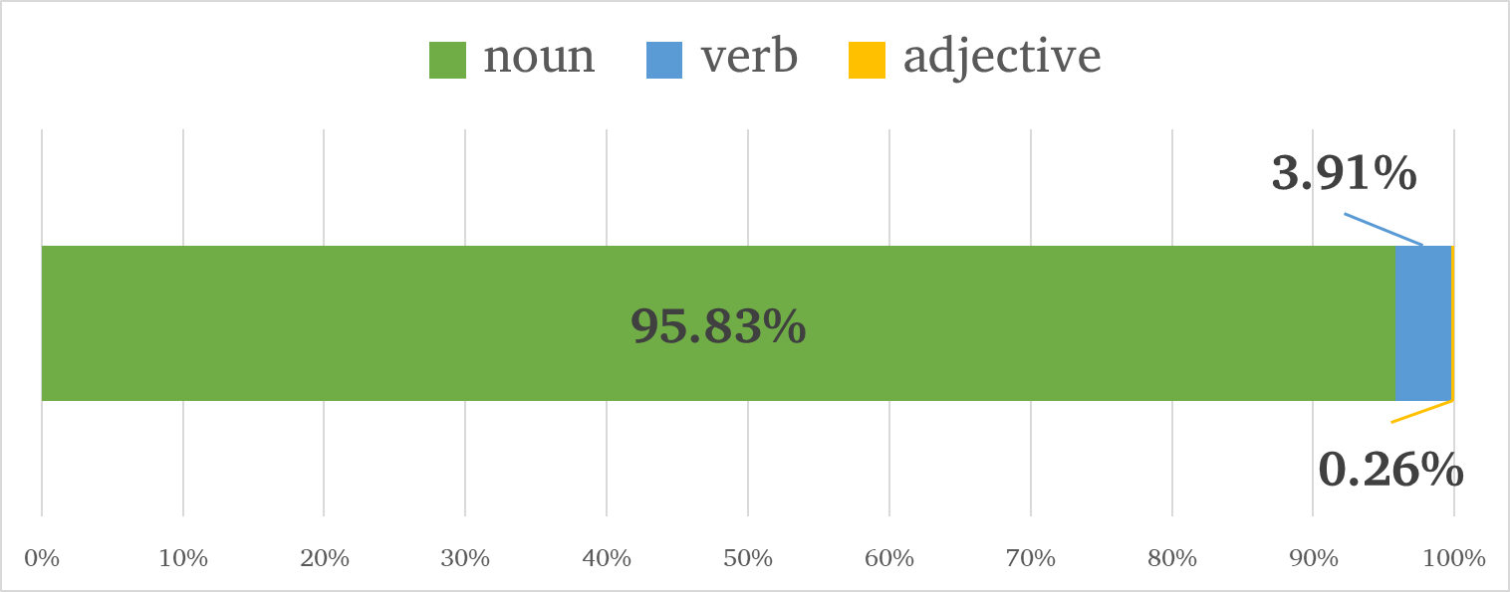
bill

Slide 52
business
N: we were in the retail milk business
V: it’s business and it’s serious
A: here’s my business card

Slide 53
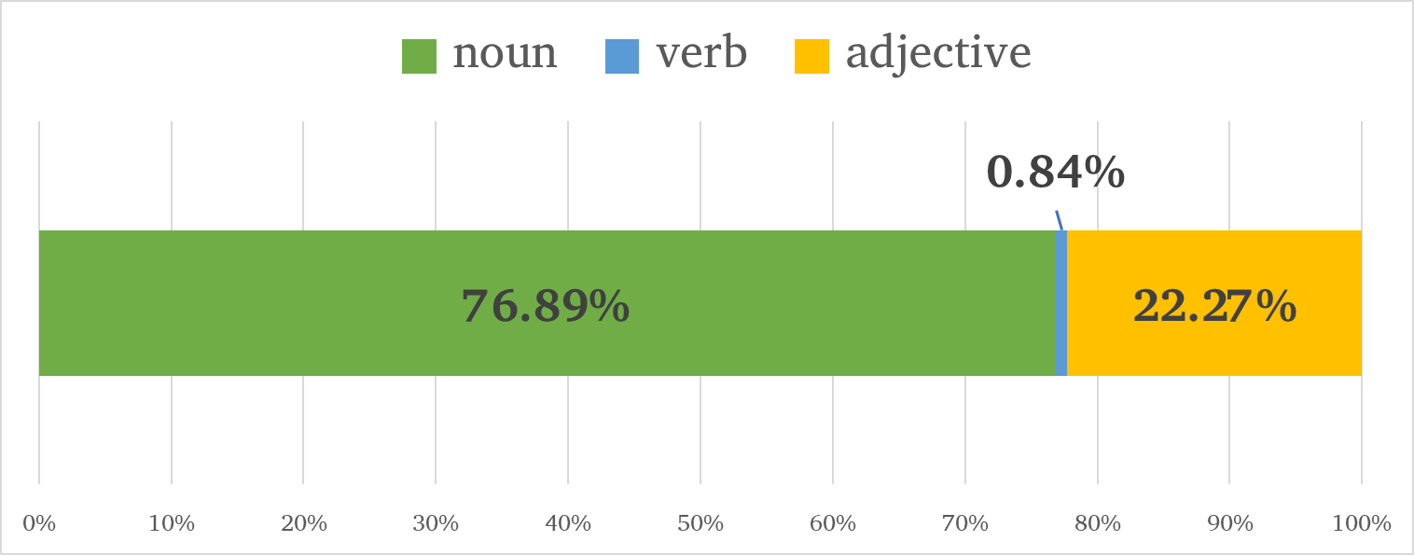
business

Slide 54
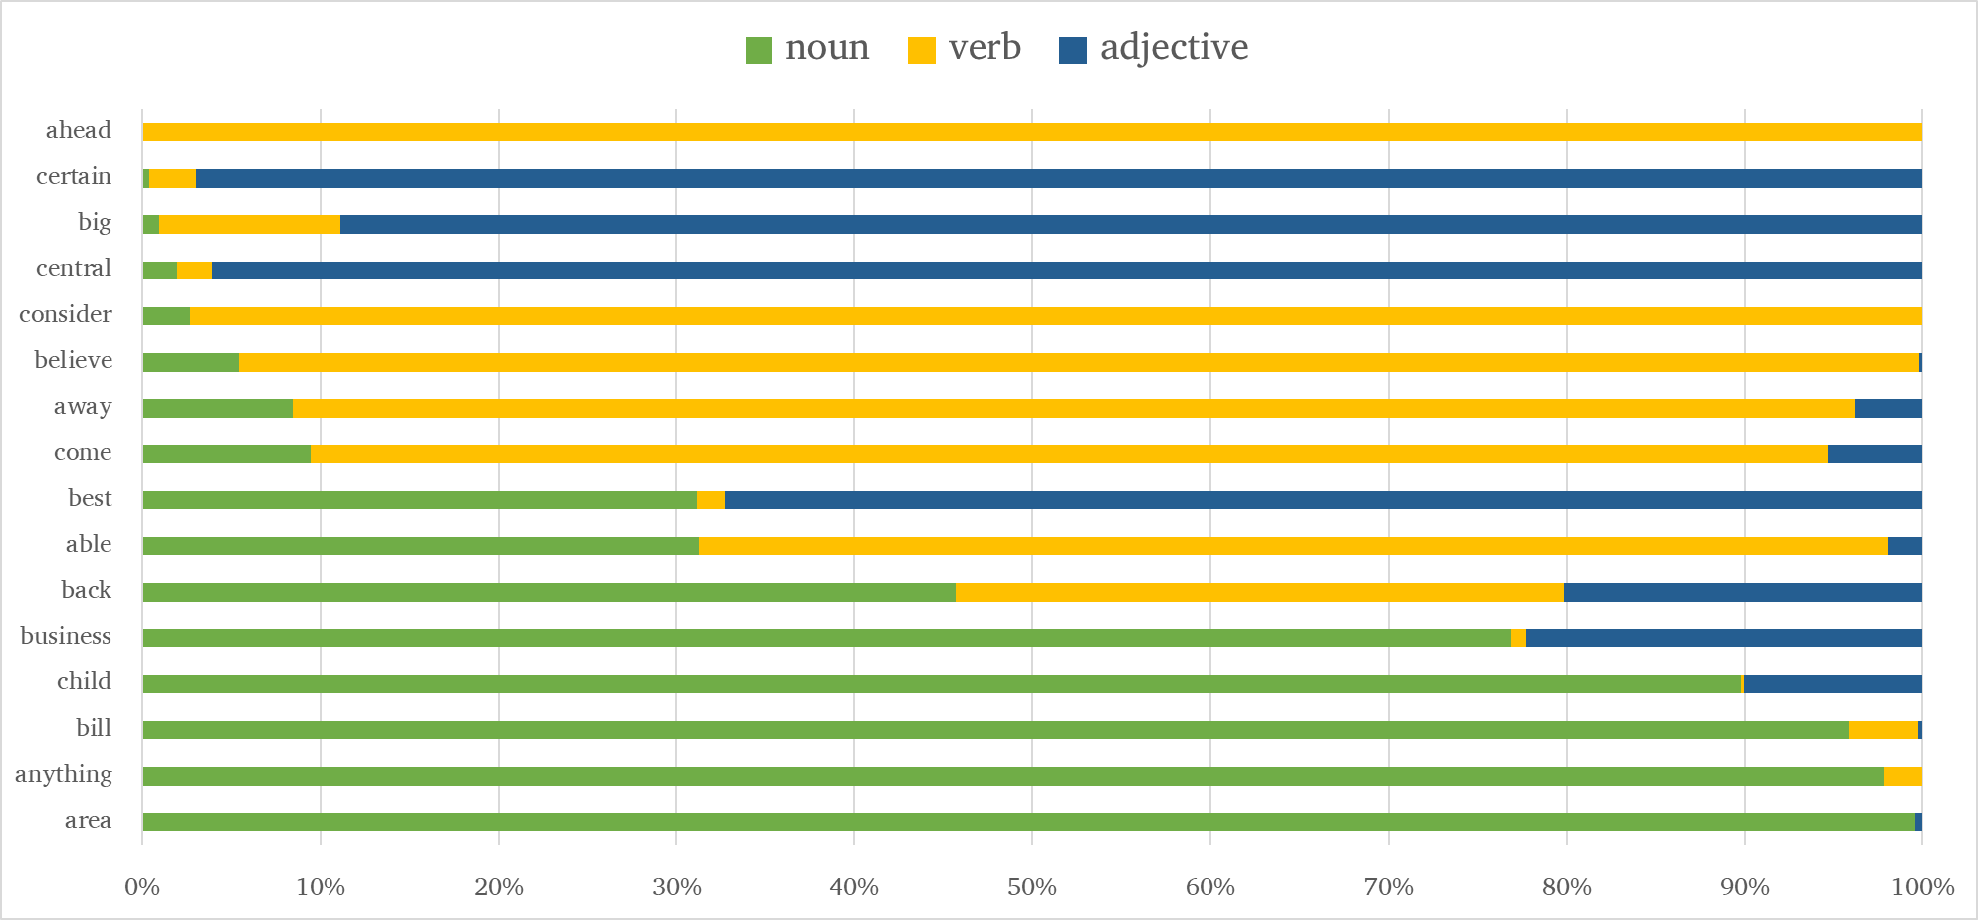
Notes:
Preliminary Results for English
Most words of English do not exhibit much flexibility – one function predominates
The results are a little boring! But that in itself is interesting!
This says something about linguists’ perception of English as a flexible language
Linguists’ perceptions seem to be based on striking, standout cases rather than actual data
(Almost) all words of English exhibit some flexibility
The only word which is 100% consistent in its distribution is ahead, which is typically thought to be an adverb!
Results would probably look very different if I included adverbial uses
verbs have nominal forms by default: verb + noun flexibility
anything can be predicated using a copula construction: omnipredicativity
back is the most evenly distributed between the three functions
Are body part terms more flexible than other semantic domains? Why?
Potential answer: The wide range of spatial and instrumental metaphors that body part terms are used for

Slide 55
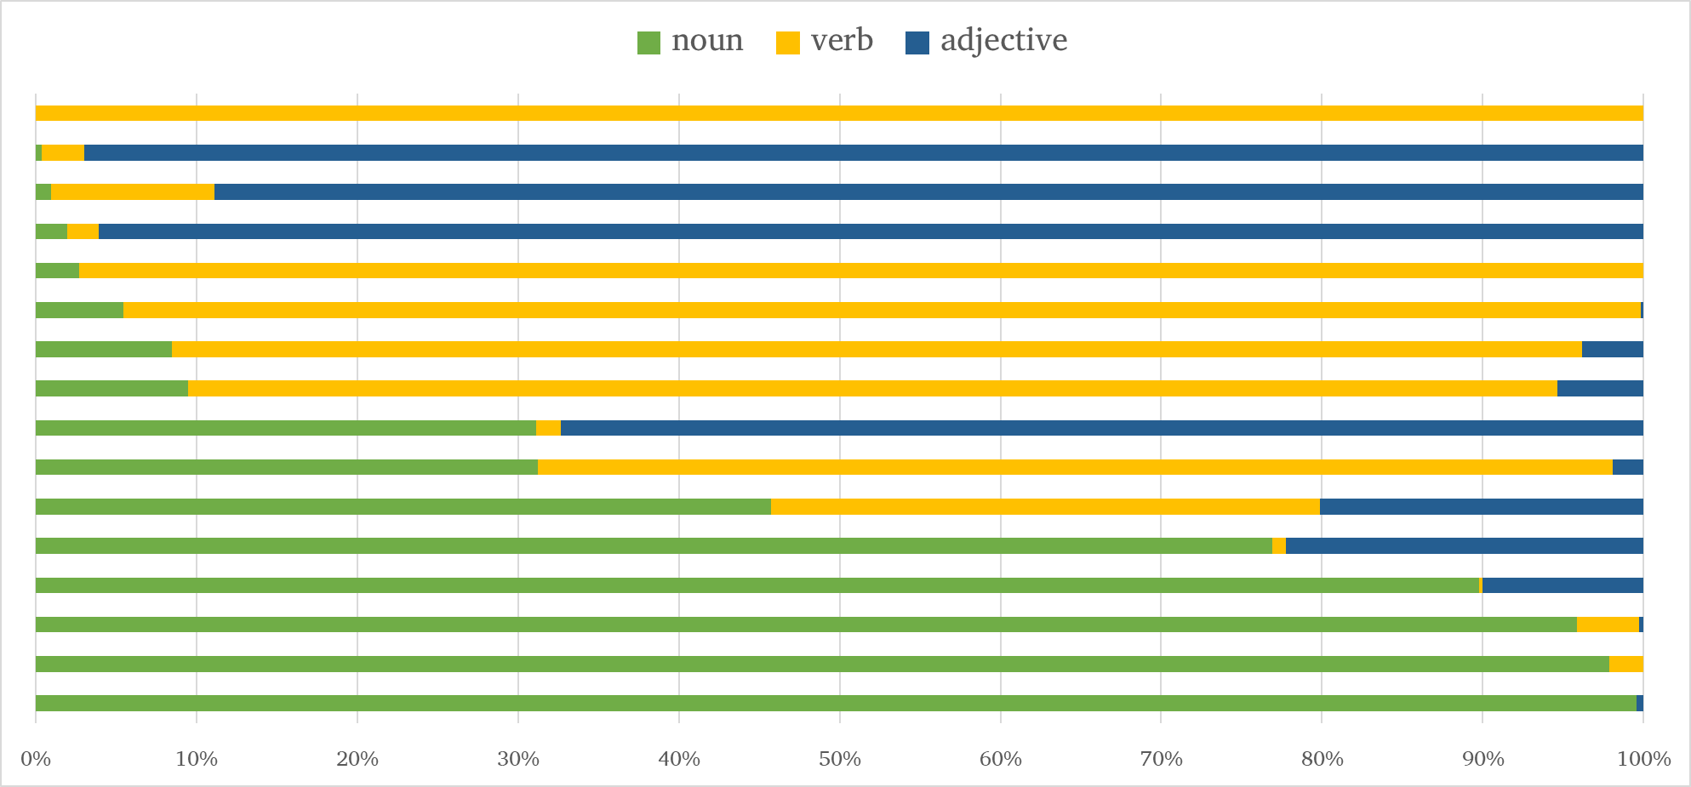
Notes:
The categories seem to be gradient – most words are not clear-cut.
Which of these are nouns? Verbs? Adjectives?

Slide 56
Preliminary Results from English
Most words of English are not especially flexible
One function tends to predominate for any given word
All (?) words of English exhibit some flexibility
Possible blocking effects (e.g. ability ↛ the able)
Body part terms may exhibit more flexibility than other semantic domains

Slide 57
Next Steps
Add data from Nuuchahnulth (and other languages)
Annotate more than 100 words per language
Code data for semantic domain, especially body part terms
Investigate historical development of flexible uses
Investigate correlations between frequency and flexibility
Notes:
Diachrony
Specific senses of a word jump the POS boundary
Consider friend: When used as a verb, it refers specifically to social media
Not all of the senses of friend immediately jumped the POS boundary along with this sense

Slide 58
Thanks!

Slide 59
Notes:
Discussion: How I got interested in this topic
POS tagging English for Rosetta Stone
lexical categories course with Elaine Francis at LSA Institute 2011
I don’t typically work with English – this is just a baseline for work with other languages

